Slide 1
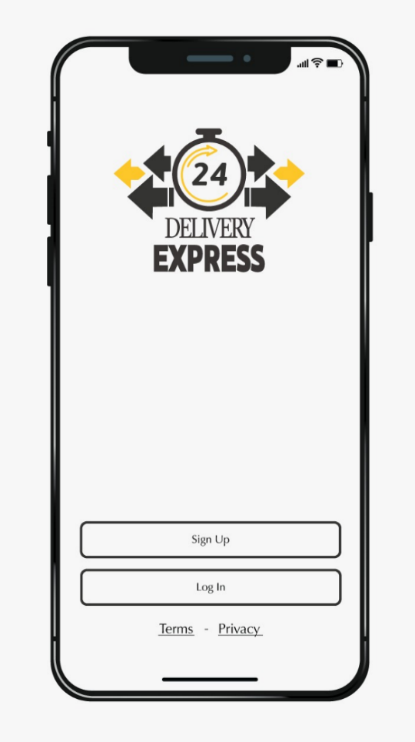
Delivery Express Application
Team members:
Mawada Khalfan Nasser Al Husaini s130786 Manar Khalid Saif Alaamri s125854
Kalsoom Kanwal Shoukat Ali s128453
Instructor: Dr. Youcef
Section: 10

Slide 2

What’s delivery express?
Project Planning
Requirement
GUI
Design
Implementation
Demo
Test
Outline

Slide 3
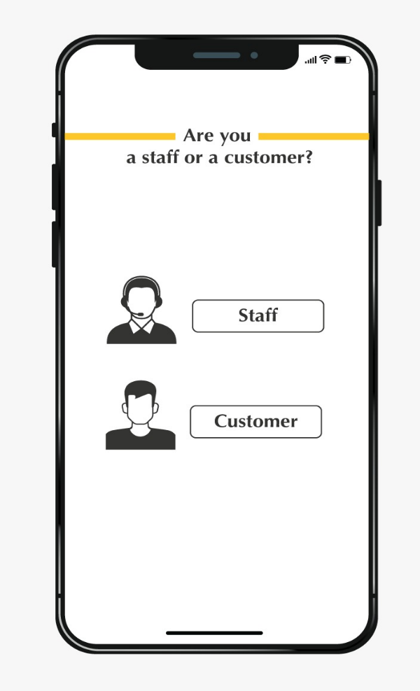
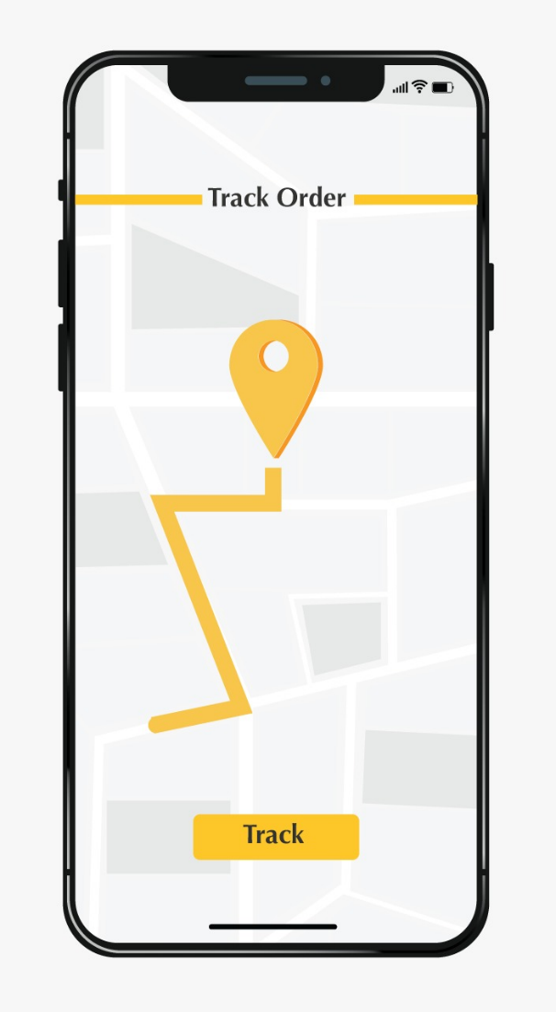
What is Delivery
Express ?
It’s an application that provides services for the
User in two different sides, one side is the customer
and the other is a staff. It allows customers to
request delivery services for numerus products
regardless of the product type. Also, it offers
job opportunities whether it was part time
or full-time job.

Slide 4
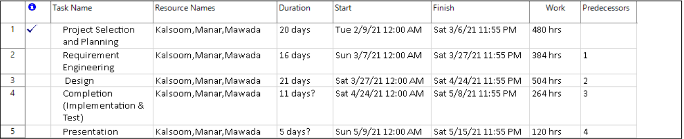
Project Planning

Slide 5
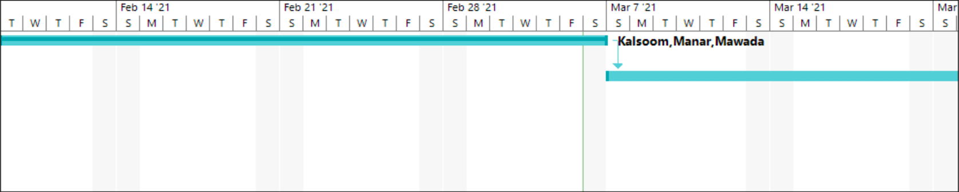
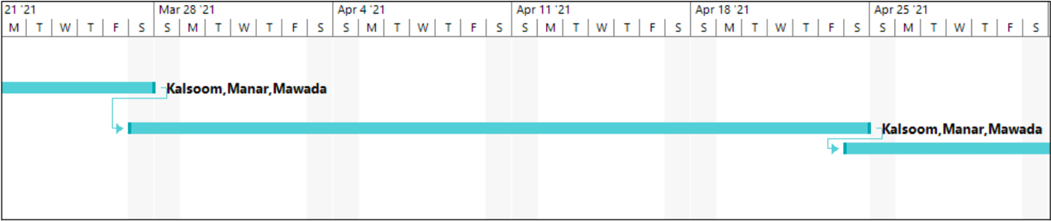

Slide 6
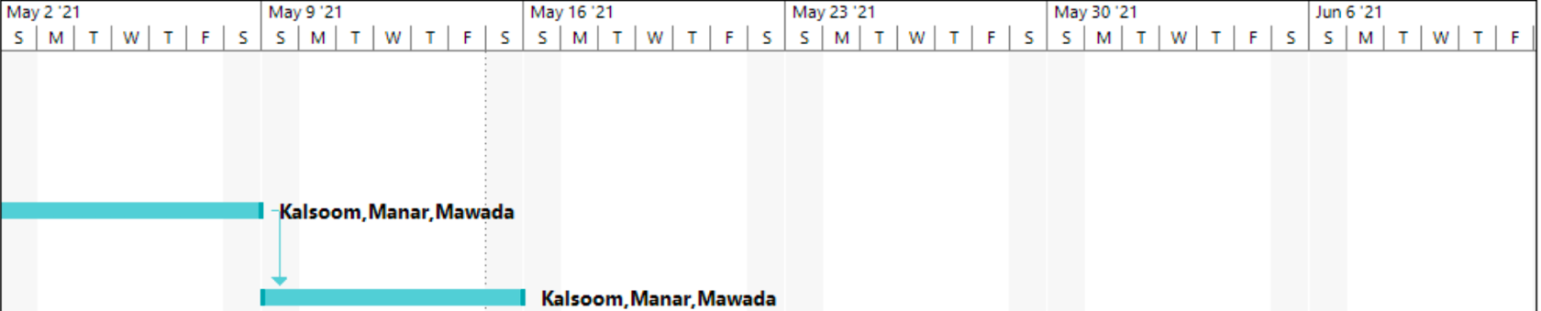
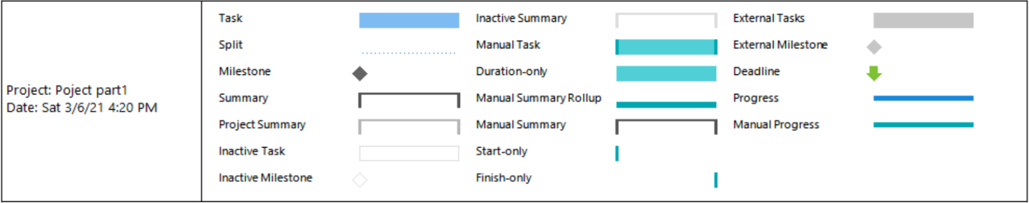

Slide 7
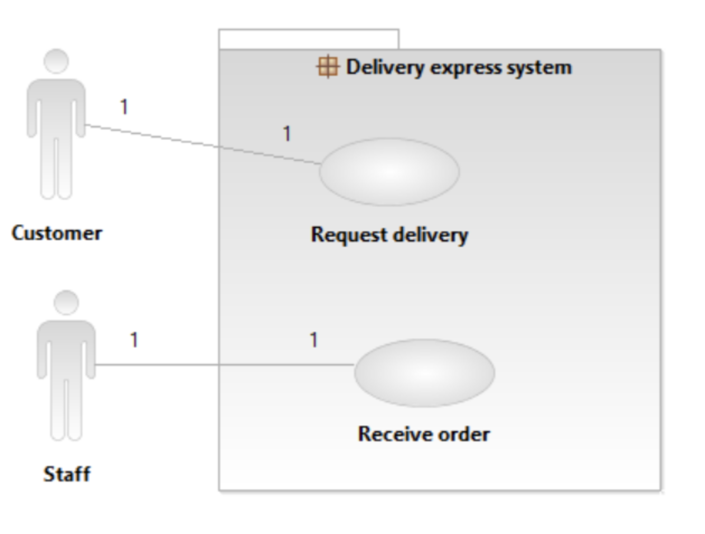
Context Diagram

Slide 8
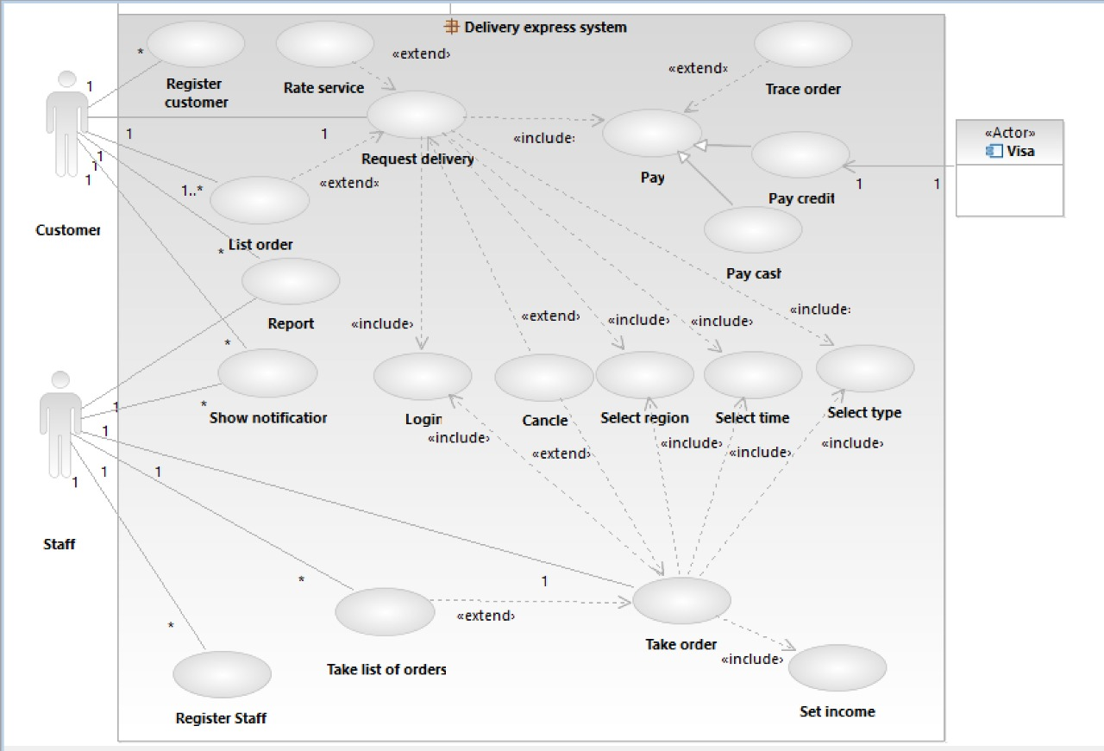
Use Case Diagram

Slide 9
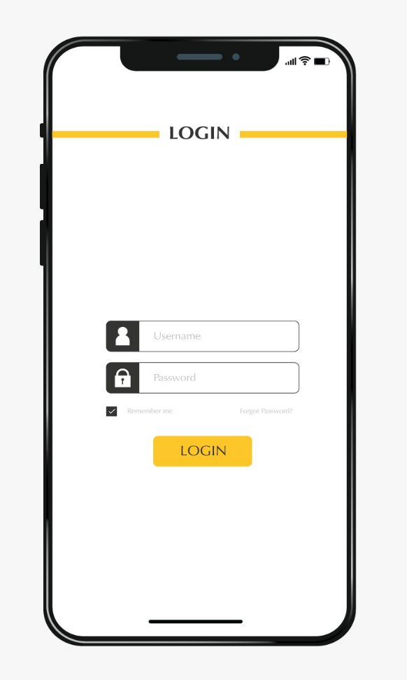
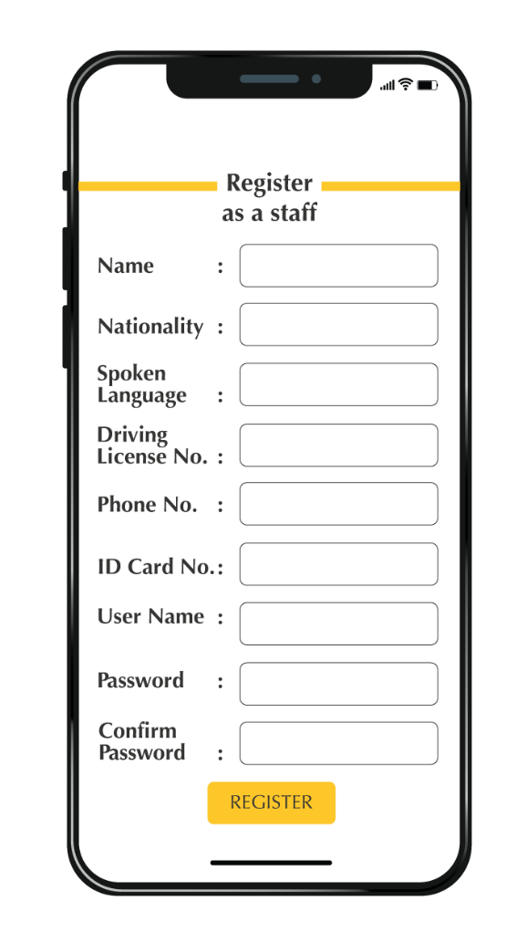
Graphical User Interface

Slide 10
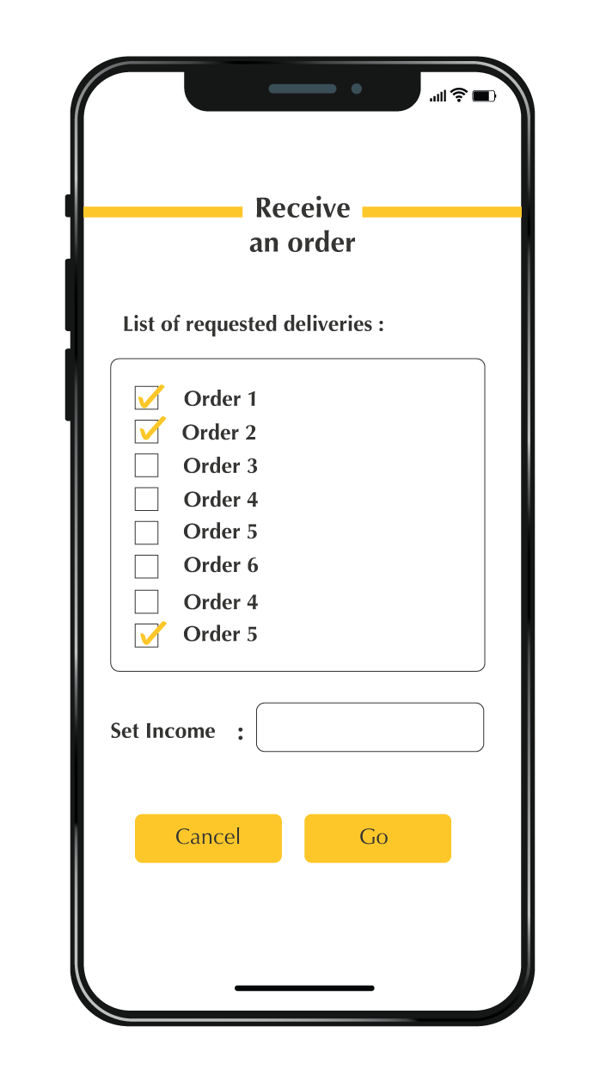
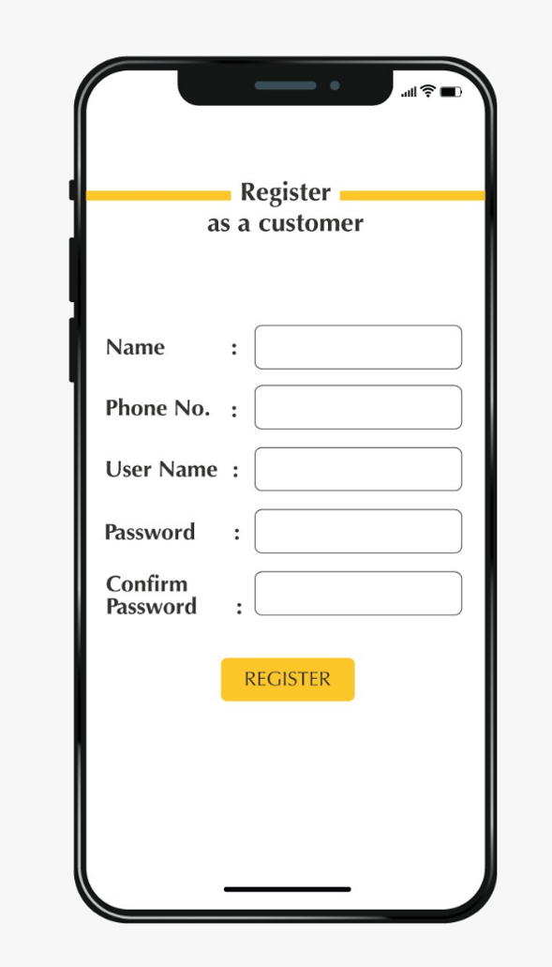
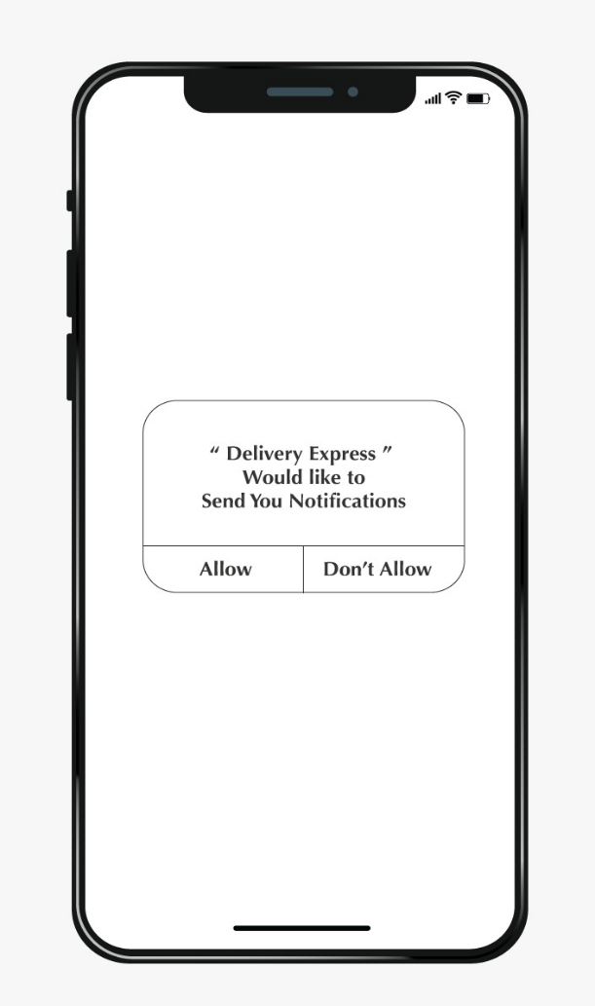
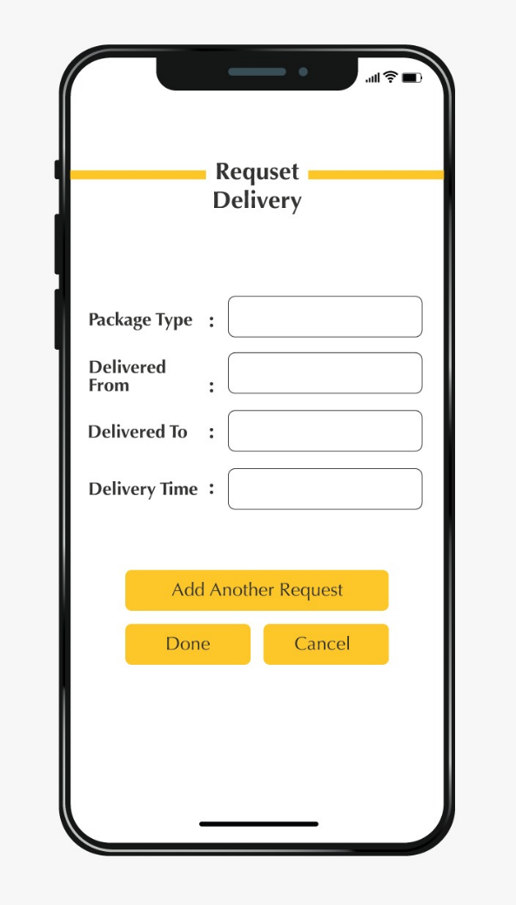
Graphical User Interface

Slide 11
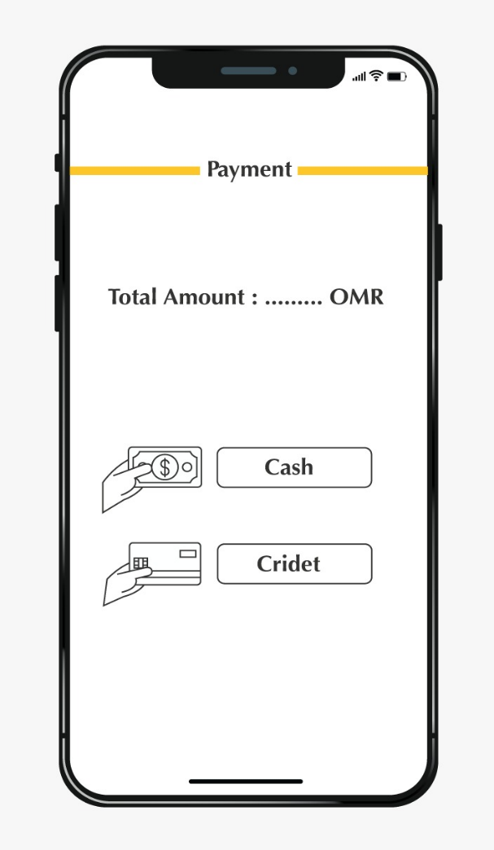
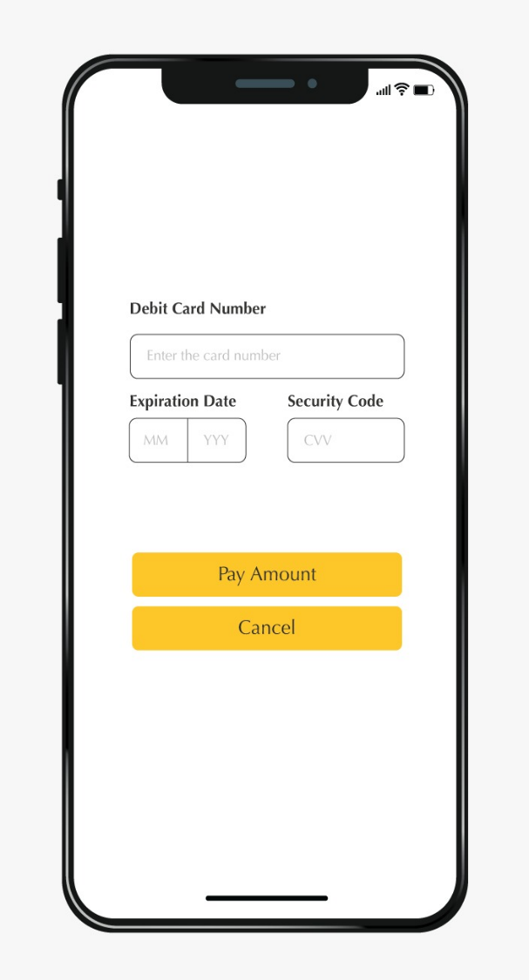
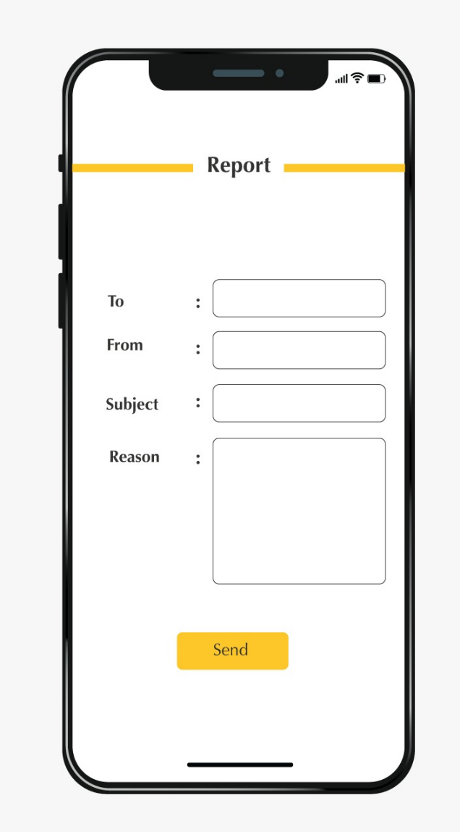
Graphical User Interface

Slide 12
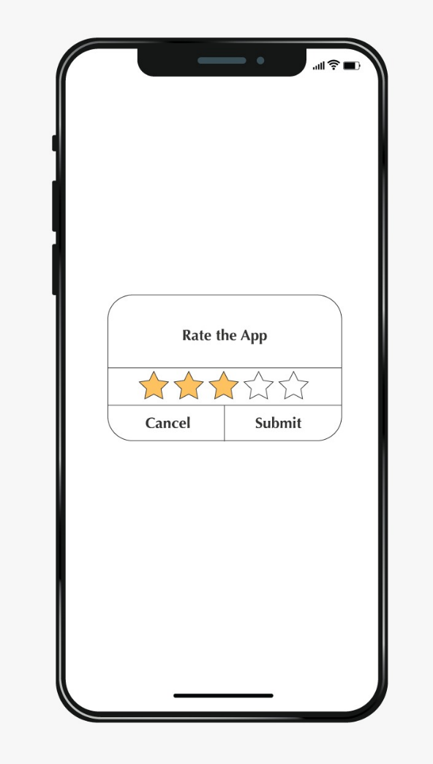
Graphical User Interface

Slide 13
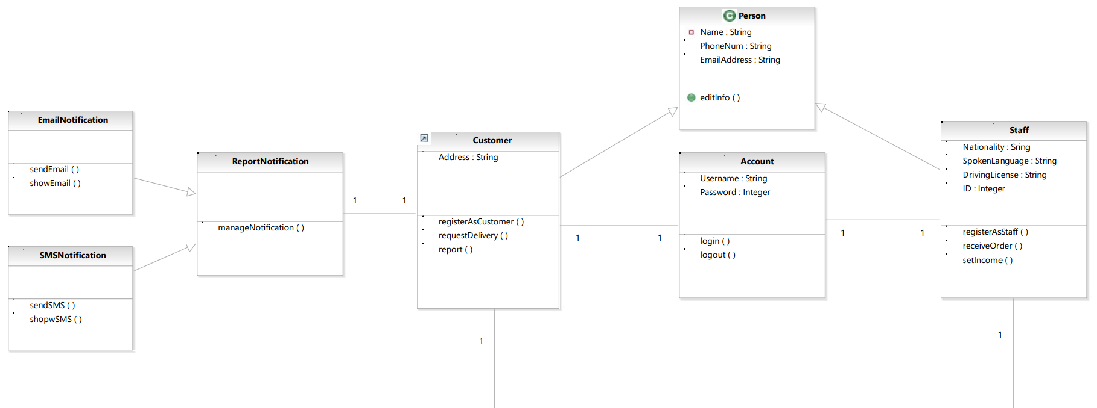
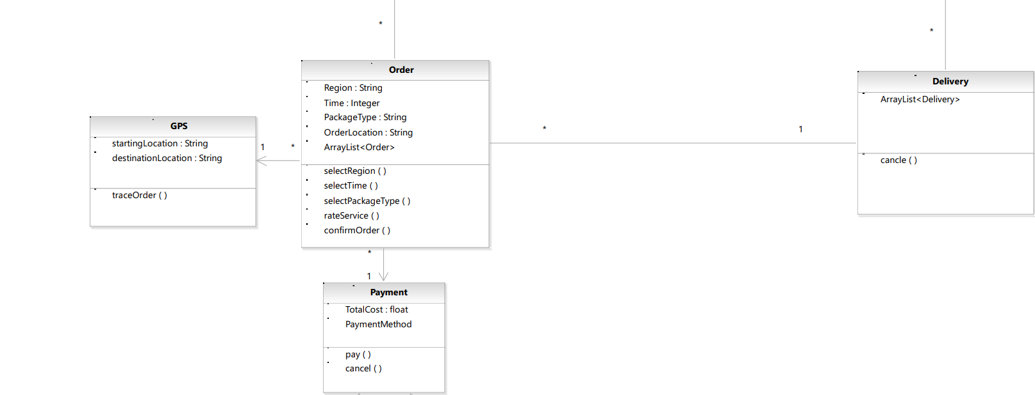
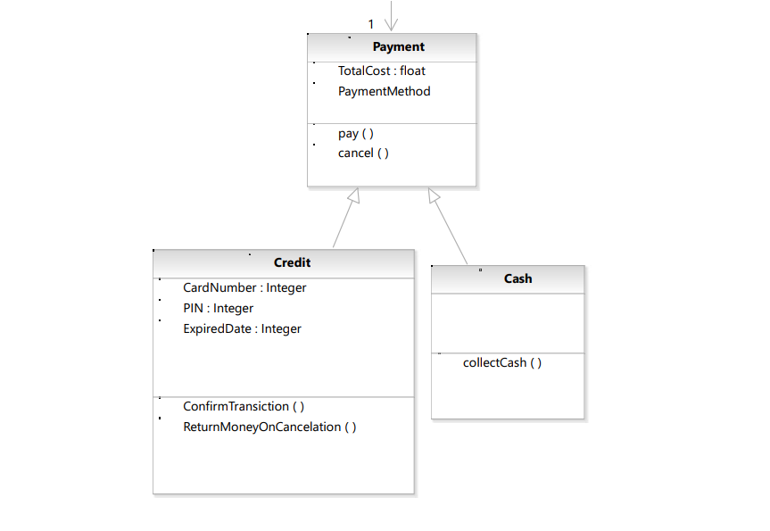
Class diagram

Slide 14
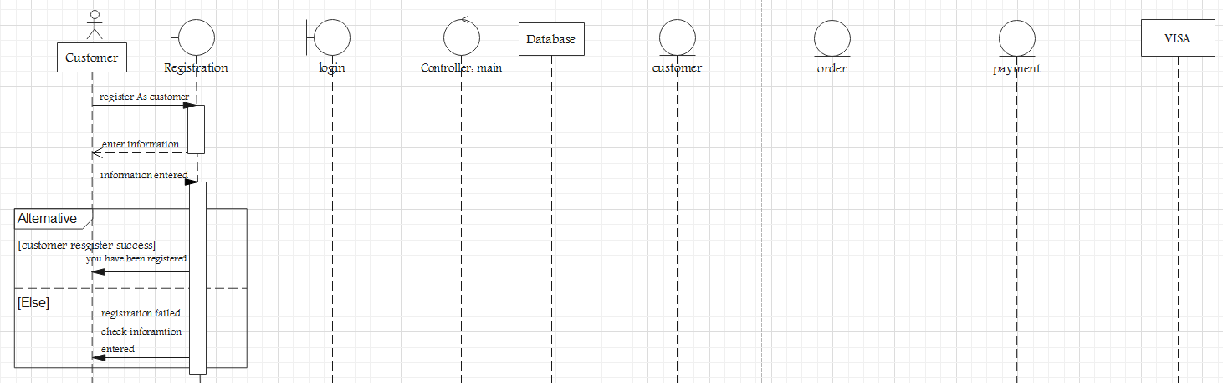
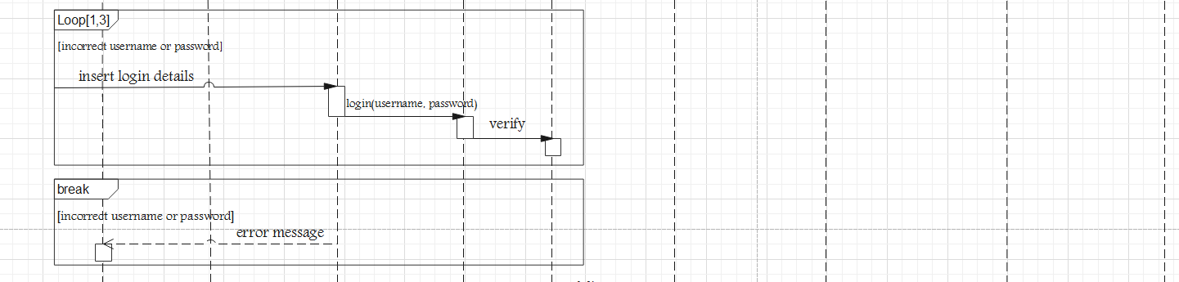
Sequence Diagram

Slide 15
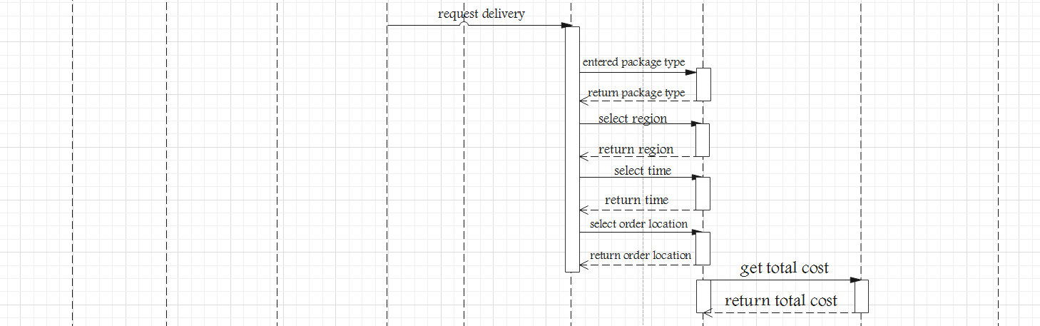
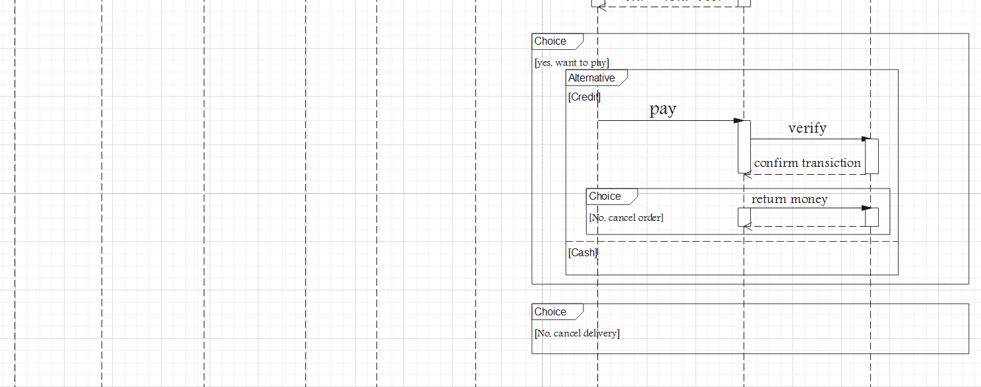
Sequence Diagram

Slide 16
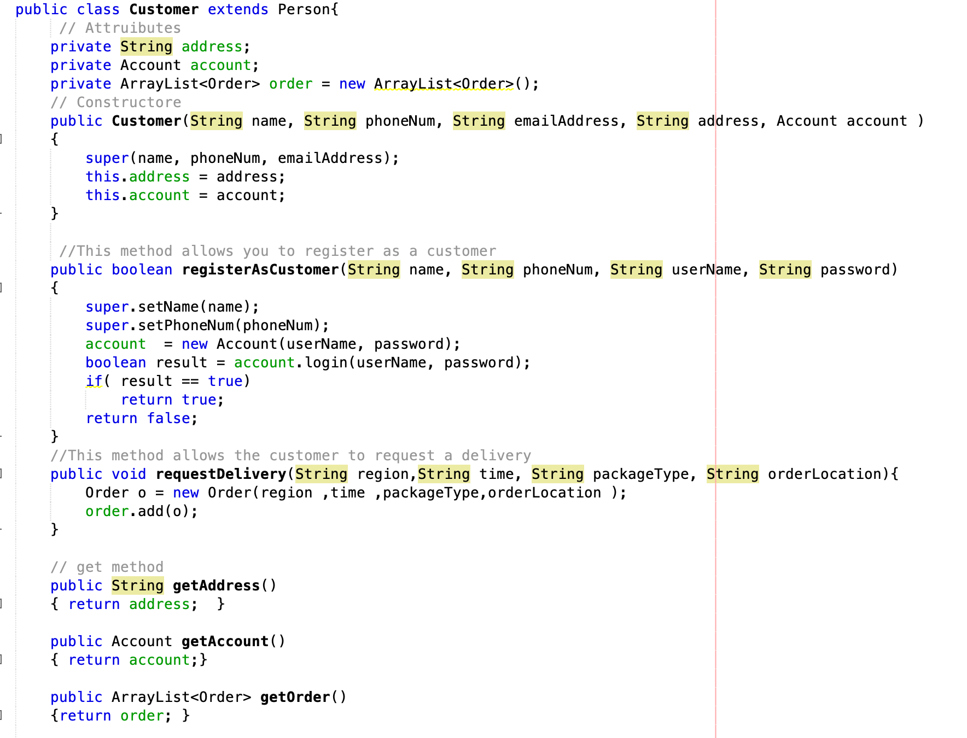
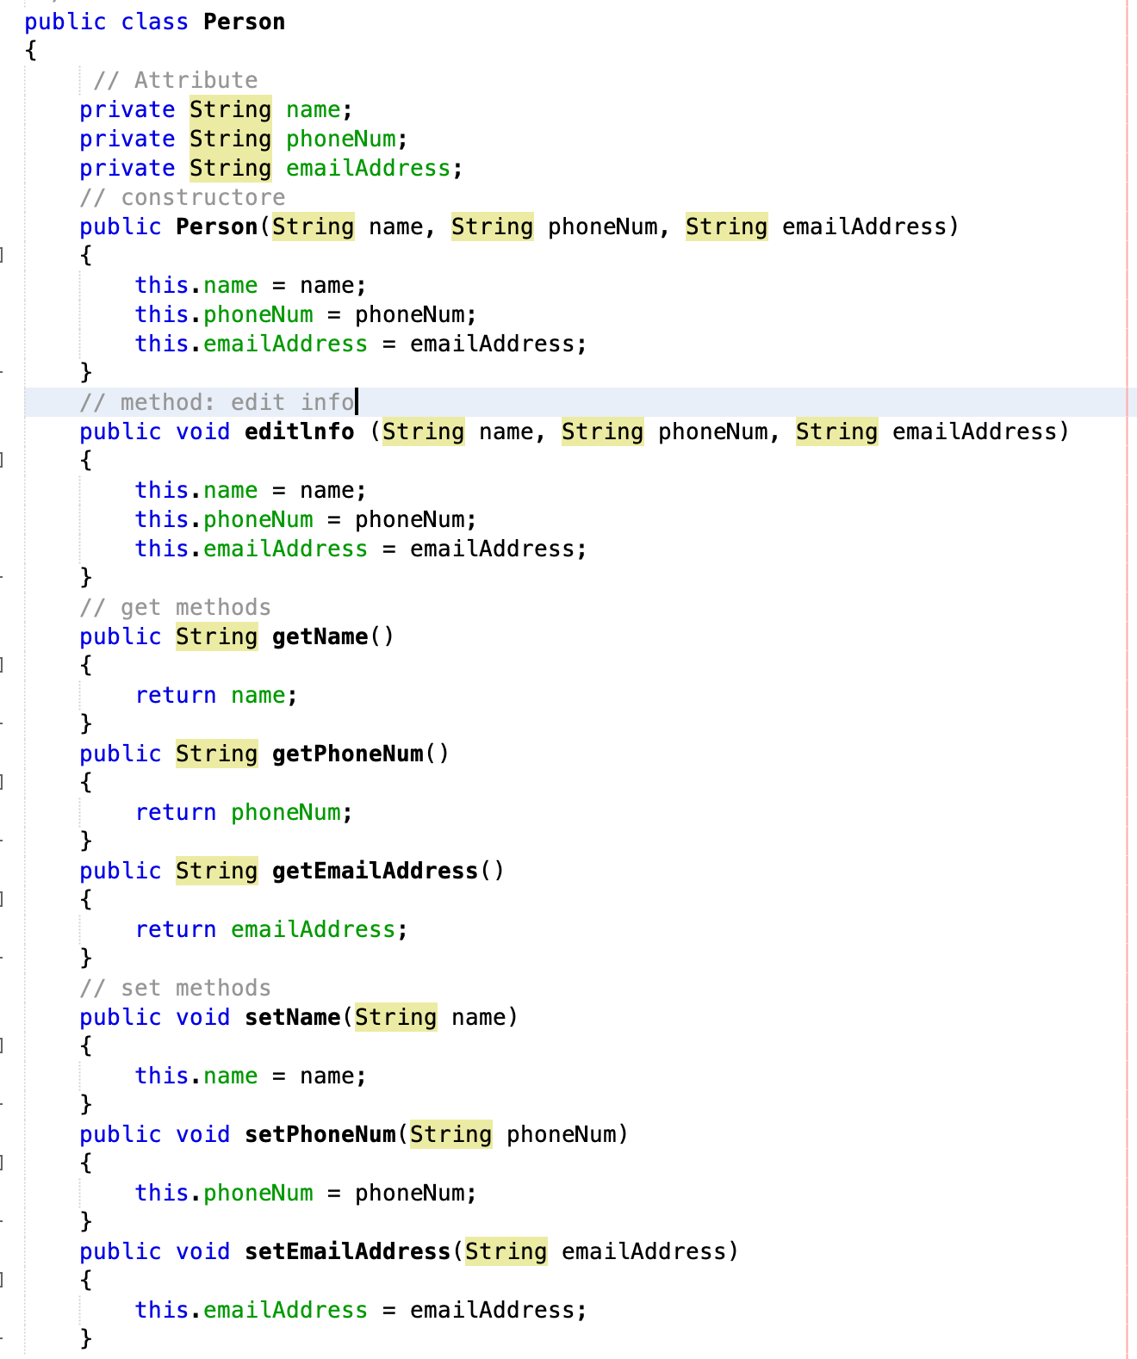
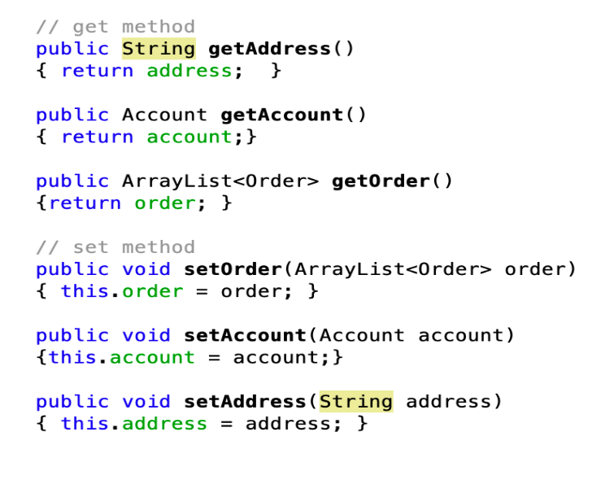
Implementation

Slide 17
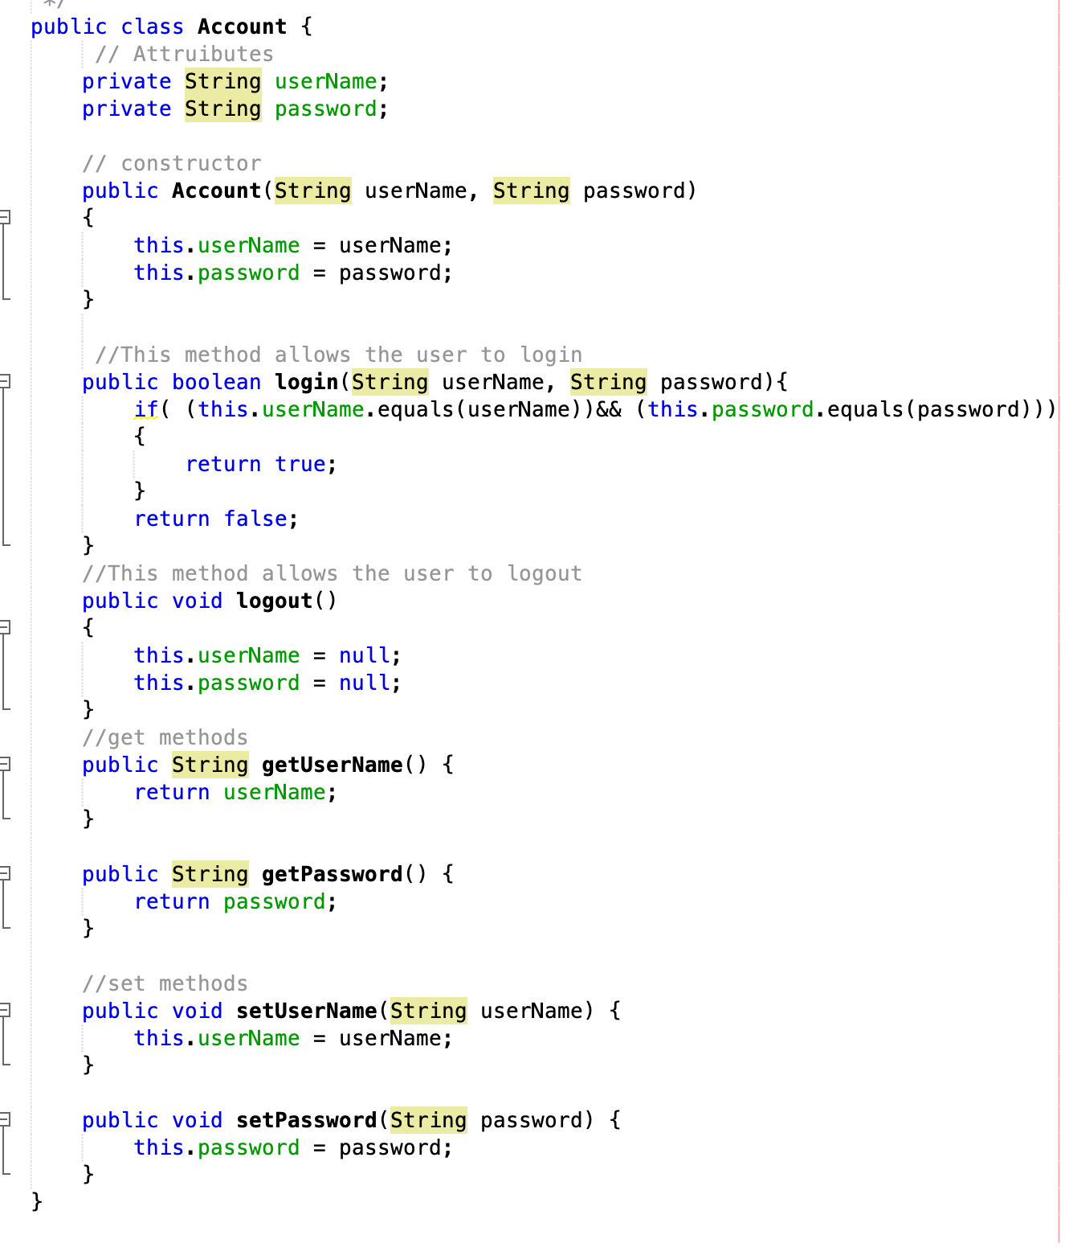
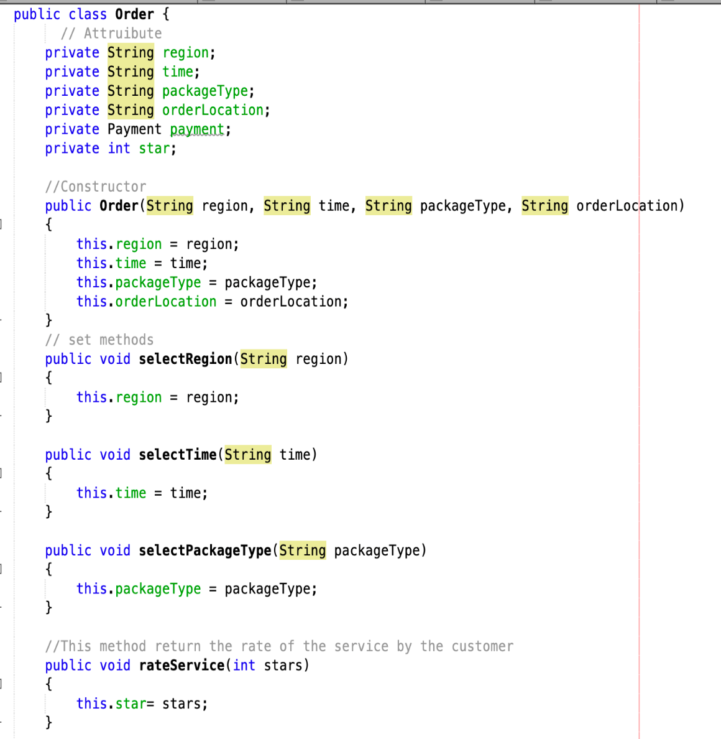
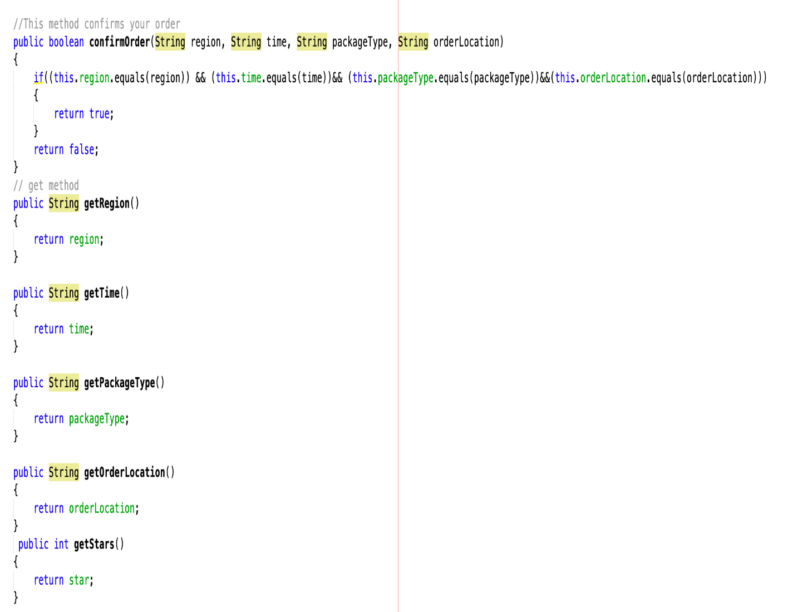

Slide 18
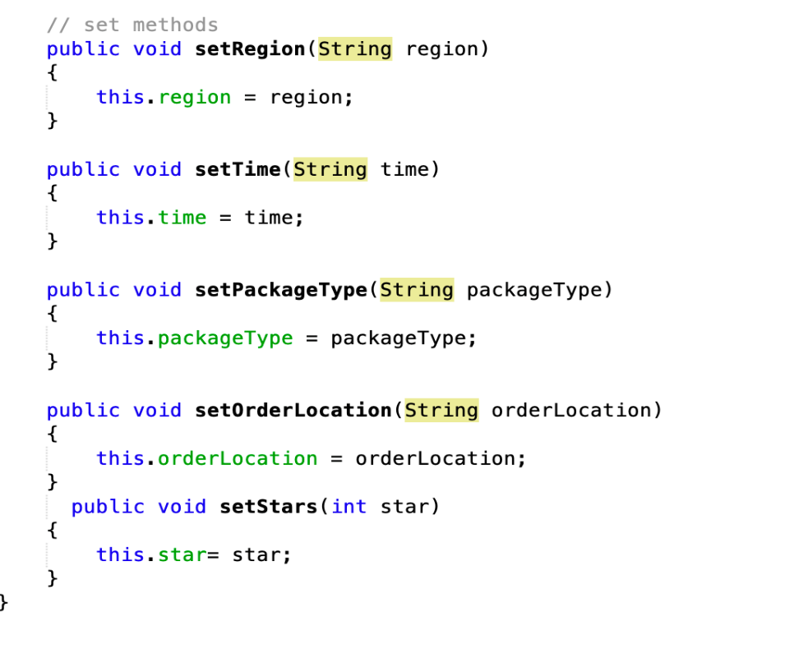
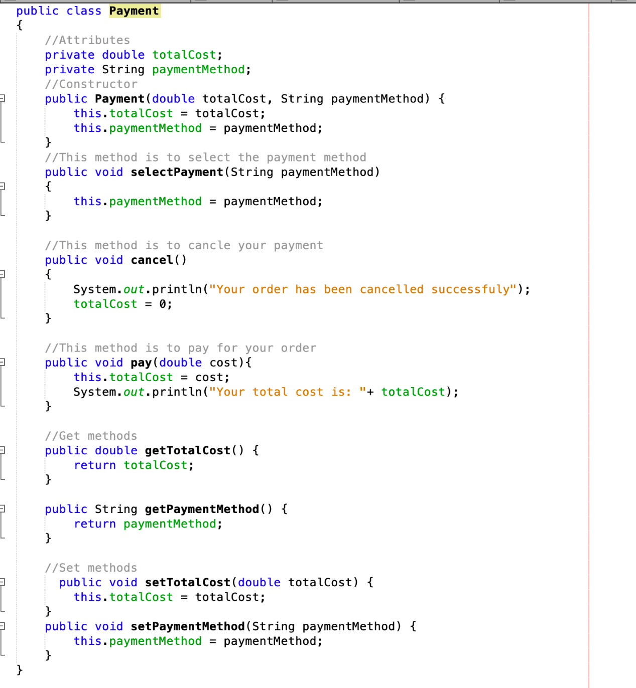

Slide 19
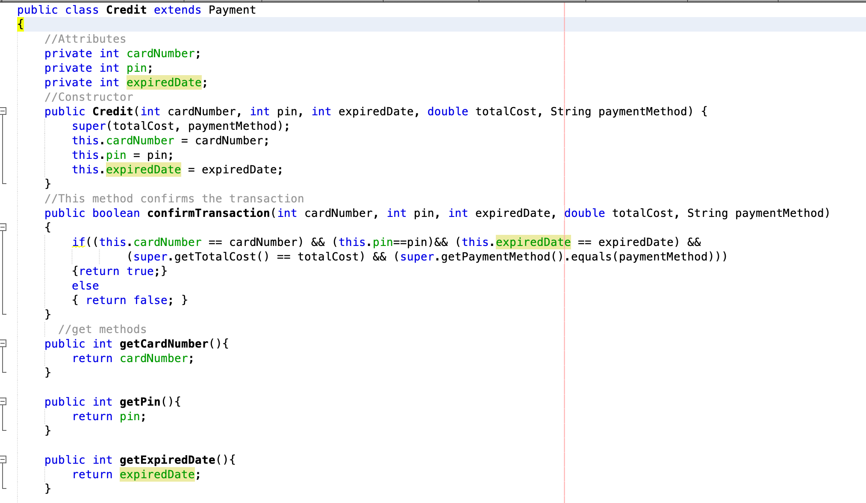
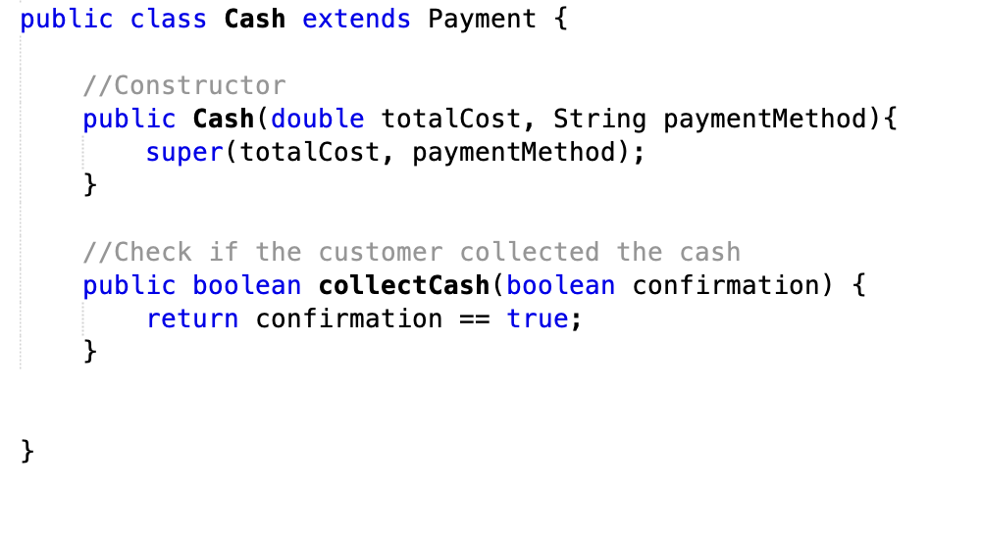

Slide 20
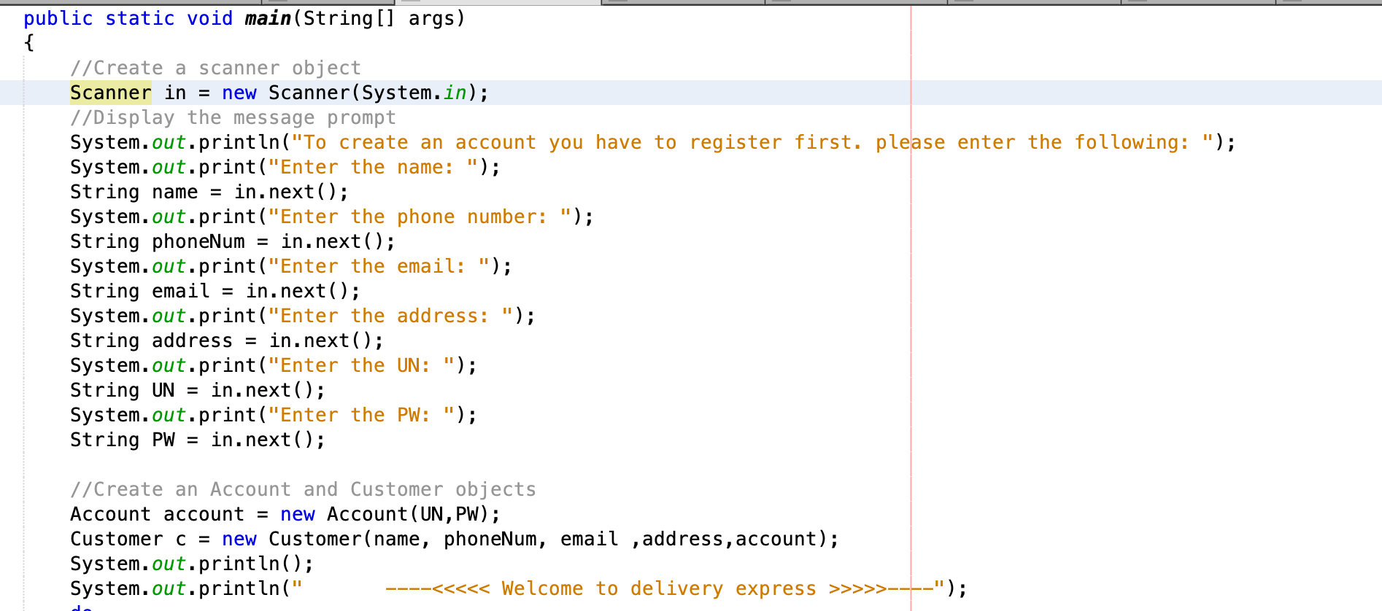
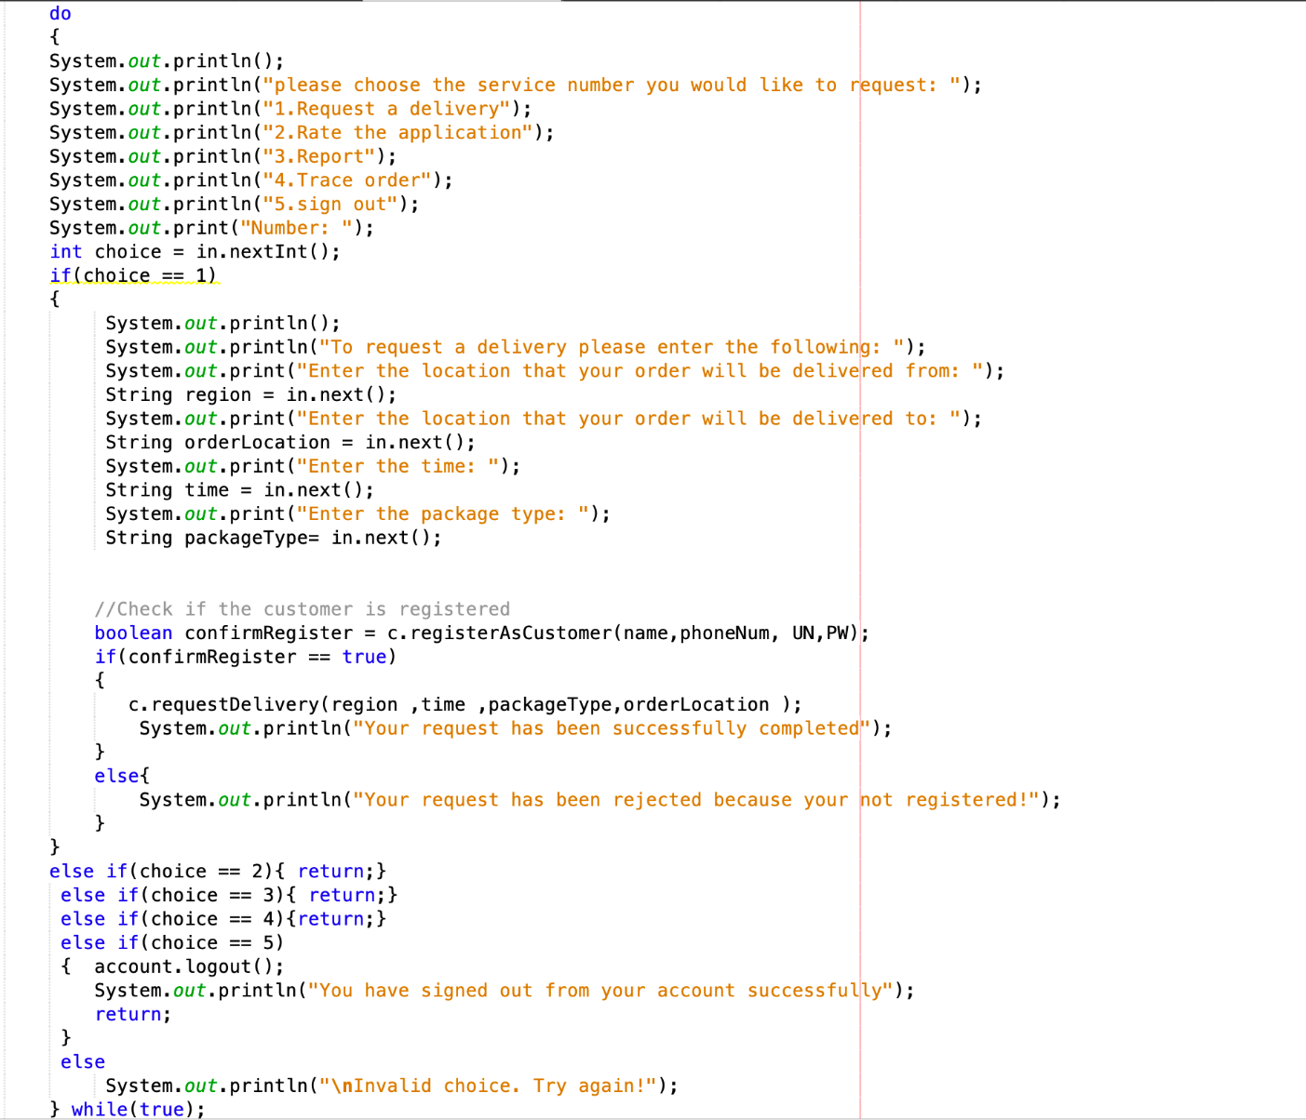

Slide 21
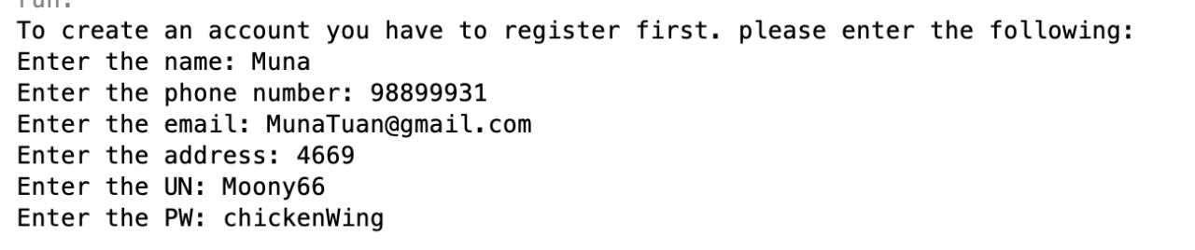
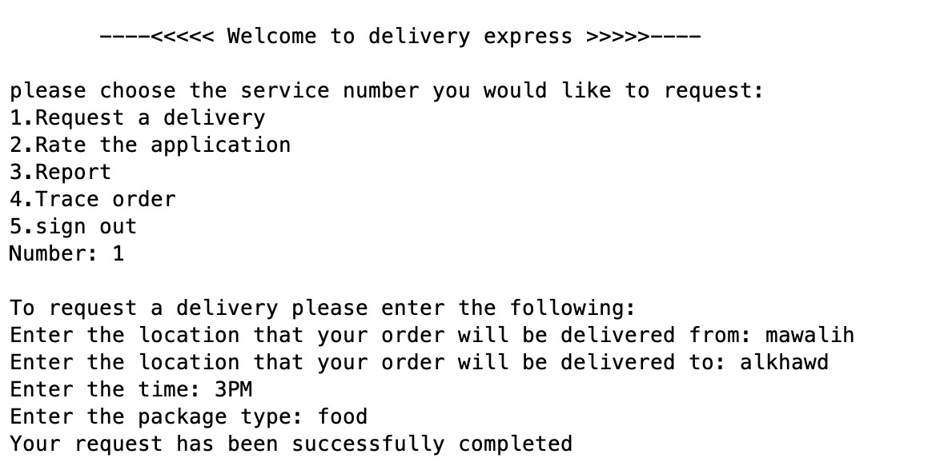
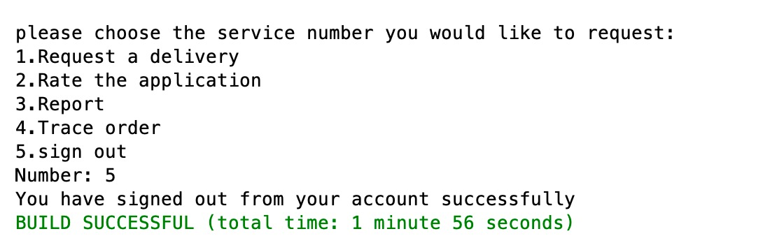
Demo

Slide 22
Testing
Test Scenario: Verifying the information entered for Registering as a customer.
Test Cases:
Test Case1: Enter valid name, valid phone number, username, and password ➔ positive.
Test Case2: Enter valid name, username, password, and invalid phone number ➔ negative.
Test Case3: Enter valid name, phone number, password, and invalid username ➔ negative.
Test Case4: Enter valid name, phone number, username, and invalid password ➔ negative.
Etc….
Test Data:
Name: Muna Ali
Phone number: 99330000
Username: Muna66
Password: 1234KK

Slide 23
Template for Test Cases:
TC ID | TC description | TC Pre-condition | TC Steps | TC Test Data | TC Expected Result | TC Post-condition | TC Actual Result | Status
TC1 | Enter valid name, valid phone number, username, and password | Need valid name, valid phone number, username, and password | - Enter Name - Enter Phone number - Enter username - Enter password - click register | Name: Muna Ali Phone number: 99330000 Username: Muna66 Password: 1234KK | Show the inbox | Inbox is shown | Inbox does show | Pass or Fail
TC2 | Enter valid name, username, password, and invalid phone | Need valid name, username, password, and invalid phone | - Enter Name - Enter Phone number - Enter username - Enter password - click register | Name: Muna Ali Phone number: 990000 Username: Muna66 Password: 1234KK | Alert | Alert is shown | Alert | Pass or fail
TC3 | Enter valid name, phone number, password, and invalid username | Need valid name, phone number, password, and invalid username | - Enter Name - Enter Phone number - Enter username - Enter password - click register | Name: Muna Ali Phone number: 99330000 Username: Muna00 Password: 1234KK | Alert | Alert is shown | Alert | Pass or Fail
TC4 | Enter valid name, phone number, username, and invalid password | Need valid name, phone number, username, and invalid password | - Enter Name - Enter Phone number - Enter username - Enter password - click register | Name: Muna Ali Phone number: 99330000 Username: Muna66 Password: 1234789 | Alert | Alert is shown | Alert | Pass or Fail

Slide 24
4. Test Script:
Name: Muna Ali
Phone number: 99330000
Username: Muna66
Password: 1234KK
1. positive test Script
registerAsCustomer(“Muna Ali”, “99330000”, “Muna66”, “1234kk”)
public boolean registerAsCustomer(“Muna Ali”, “99330000”, “Muna66”, “1234kk”) {
super.setName(Muna Ali);
super.setPhoneNum(99330000);
account = new Account(“Muna66”, “1234kk);
boolean result = account.login(“Muna66”, “1234kk);
if( result == true) return true; // it returns true ➔ registered successfully
return false;
}
2. Negative test Script
registerAsCustomer(“Muna Ali”, “990000”, “Muna66”, “1234kA”) //invalid phone number
public boolean registerAsCustomer(“Muna Ali”, “990000”, “Muna66”, “1234kk”) {
super.setName(Muna Ali);
super.setPhoneNum(990000);
account = new Account(“Muna66”, “1234kk);
boolean result = account.login(“Muna66”, “1234kk);
if( result == true) return true;
return false; // it returns false ➔ registration is unsuccessfull
}

